Slide 1
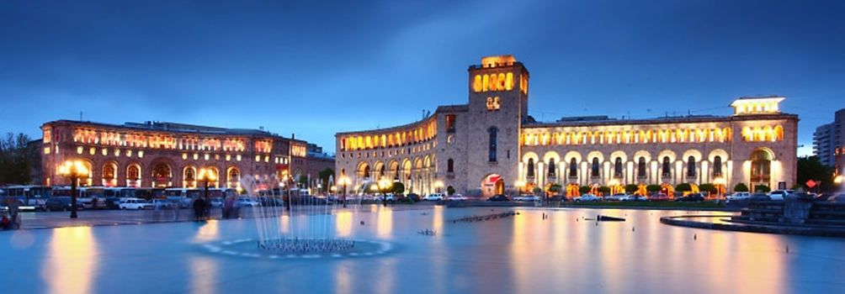
Modernization of Environment Protection Studies
Programmes for Armenia and Georgia
Kick-off meeting
January 13-16, 2019
Yerevan, Armenia
MENVIPRO aims to facilitate the modernization of the University studies in the field of Environment Protection in the Region of South Caucasus by transferring European best practices and applying principles of Quadruple Helix.
The overall objective of the project is to significantly improve the quality of postgraduate studies in the field of Environment Protection in Armenia and Georgia on the basis of complex modernization of postgraduate studies in line with the Bologna principles, Salzburg principles of EAU and best European practice.
The system of postgraduate studies is an important element of HE system of any country as it lays a foundation to innovative economy and competitive science system. Extending the Bologna principles to this area of education corresponds fully to the trends and needs of European and global economies and lays in the area of priorities for education reforms in Armenia and Georgia.
The thematic area of EP represents a lasting and important priority both in Europe and in the target countries. Capacities in EP is a core prerequisite for ensuring quality of life and competitiveness of economy, especially for such small countries as Armenia and Georgia.

