Slide 1

School of Science and Technologies

Slide 2
History of School
2004
Informatics
BSc, PhD
Math BSc
2012
Electrical and Computer Engineering BSc
2014
2018
IT management
BSc, MSc, PhD
Applied Science MSc
Science and IT,
PhD

Slide 3
School of Science and Technologies
Department of
Information technologies
Department of
Natural Sciences
Department of
Mathematics
IT Academy(Microsoft, Cisco, Oracle, IoS Dev, MicroTIk
Institute of Mathematics
UG-Lemondo training center
Engineering lab
UG-Robotoics Academy
UG-Edison training center
Cisco lab
BlokChain Lab
Internet Dvelopment Center
Department of
Engineering
Physics
Biology
Chemistry

Slide 4
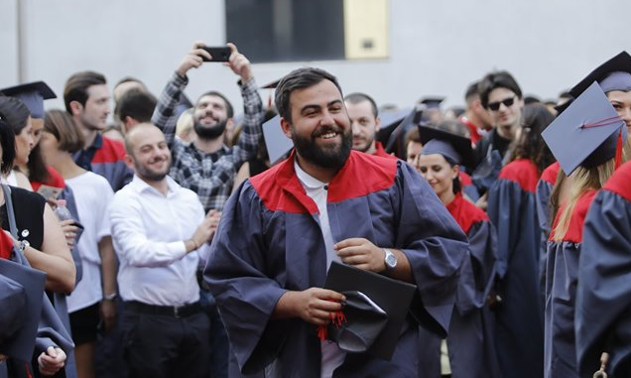
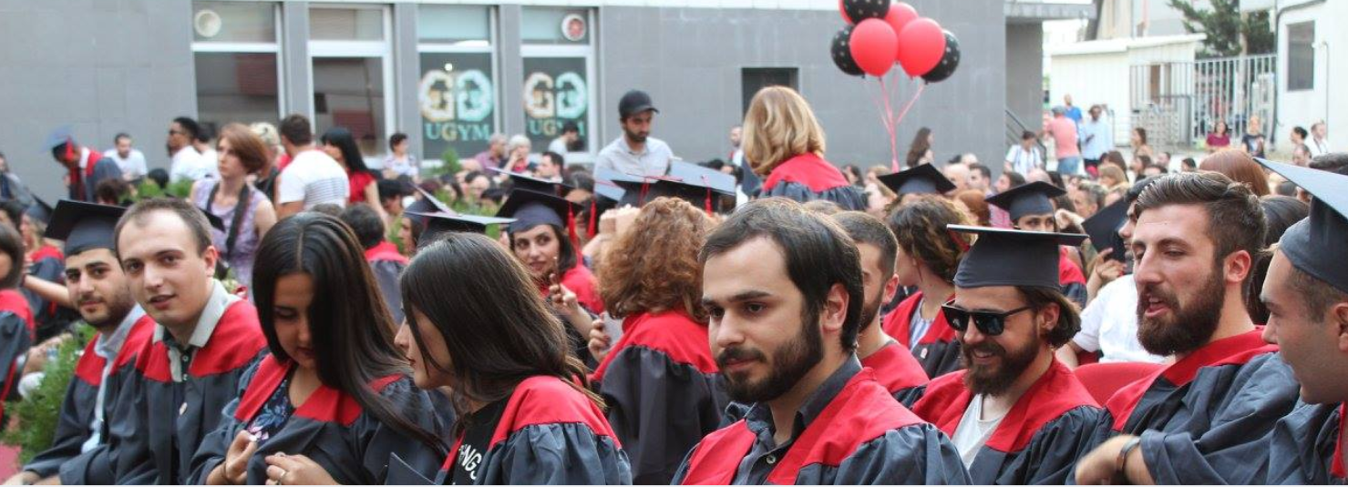
Undergraduate Programs - BSc
Mathematics
Electrical and Computer Engineering (Geo, Eng)
Information Technology (Geo, Eng)

Slide 5
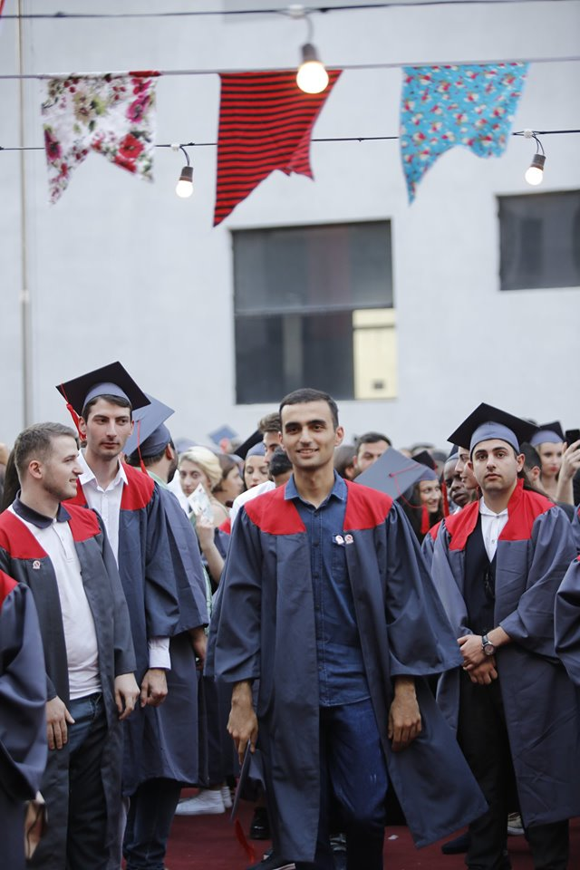
Graduate programs
Information Technology (Geo, Eng)
Blockchain - Distributed Information Systems
Management of Information Technology
Applied sciences (Physics and Math)
Information technologies PhD
Physics PhD
Mathematics PhD

Slide 6
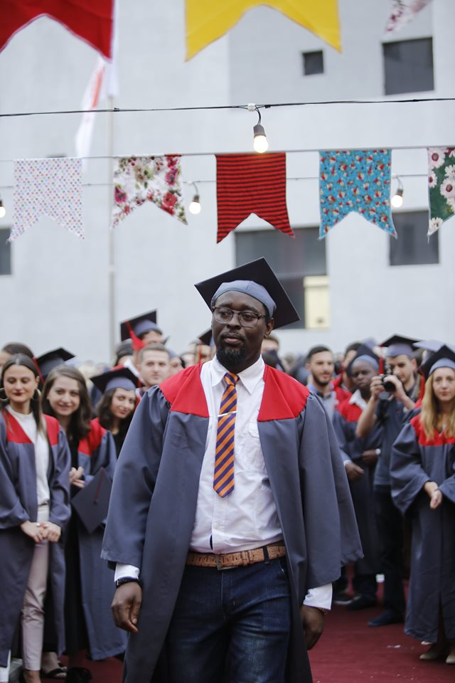
International students
Nigeria

Slide 7
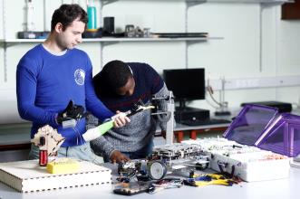
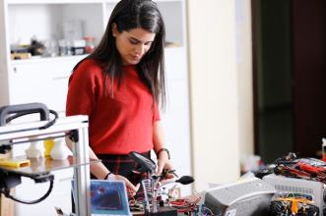
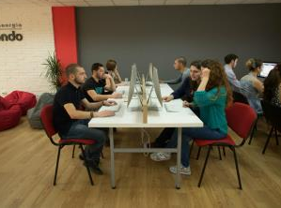
Study methods
Practical studies
Problem oriented studies
Team work
Digital technologies in class
E-learning, eExams

Slide 8







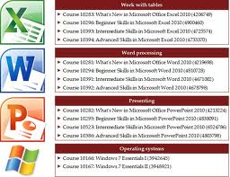


UG Training Centers

Slide 9
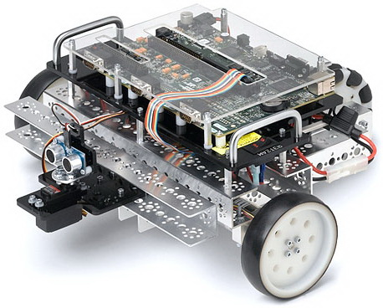
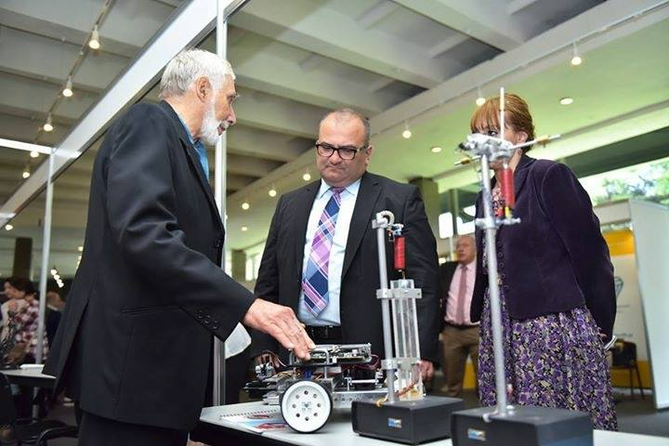
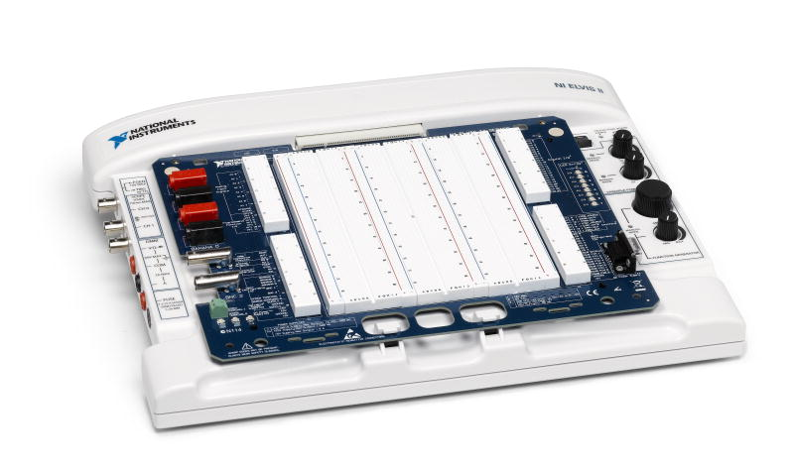
Engineering Lab
The engineering laboratory is equipped with modern training laboratory equipment (Pasco, National Instruments). In addition, they have unique lab equipment that is managed through LabView.
In the engineering lab, students have the opportunity to learn the basics of engineering and the laws of physics in general by observing them directly.

Slide 10


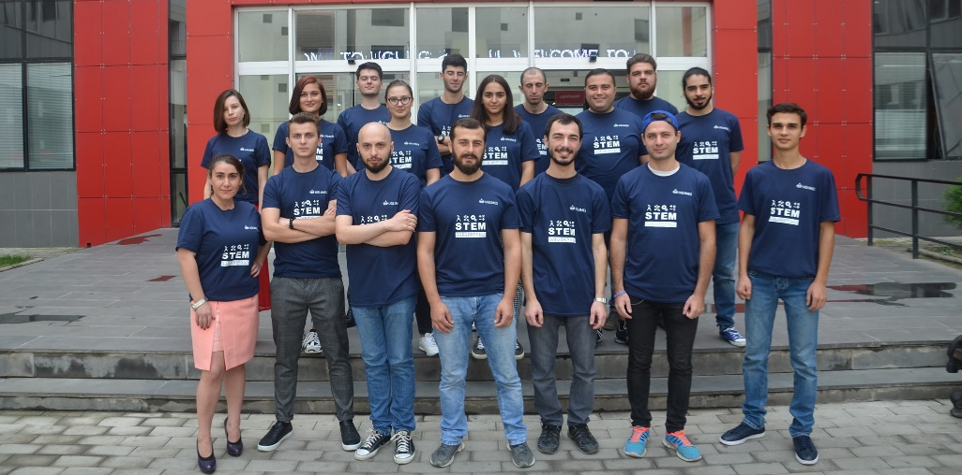
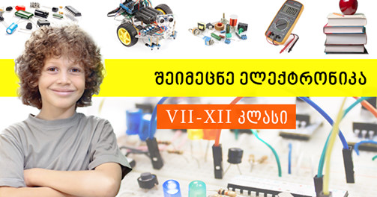
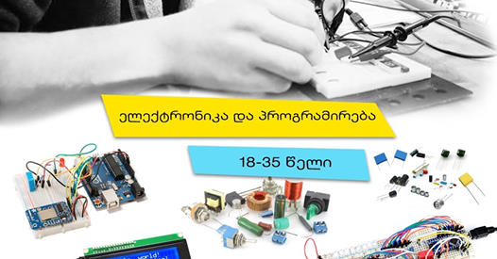
UG Robotics and Electronics lab for everyone
The UG-Limes Robotics and Electronics Lab offers unique and innovative learning programs to learn electronics and create Robots with Arduino. Discover Electronics Designed for high school students will learn how to physically works electronic devices, design and create their own electrical circuits, small robots.
Students of Electronic and Computer engineering are involved in the teaching process as Instructors

Slide 11

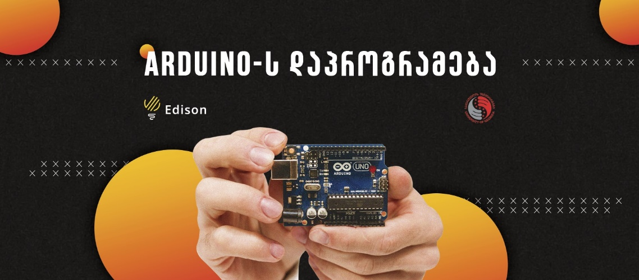

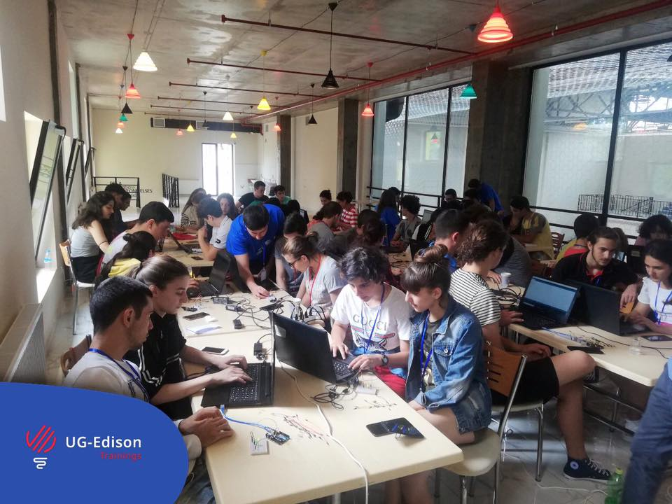
UG Edison training Center
The UG-Edison offers Arduino programing training courses and Smart House applications for students from age 10 and for adults, Summer Schools in Programing.
Students of Electronic and Computer engineering are involved in the teaching process as Instructors

Slide 12




Research and Education
Modernization of Mathematics Curricula for Engineering and Natural Sciences in South Caucasian Universities by Introducing Modern Educational Technologies
2013-2017
The aim of the MathGeAr project is to improve the quality of MINT training in Georgia and Armenia by modernizing and improving students’ academic education in mathematics, and to encourage modernization of mathematics as a subject of study. Using blended learning scenarios and e-learning technologies represents the first step towards modernizing mathematical learning content and teaching methods. One focal point of the project is to support teachers and the university staff responsible for e-learning.

Slide 13


Research and Education
Modernization of Environment Protection Studies Programmes
for Armenia and Georgia,
2018-2021
The overall objective of the project is to significantly improve the quality of postgraduate studies in the field of Environment Protection in Armenia and Georgia on the basis of complex modernization of postgraduate studies in line with the Bologna principles, Salzburg principles of EAU and best European practice.

Slide 14
Study Courses offered by UG
WP2 Curricula development
Environmental geochemistry
Environmental monitoring and measurement devices
Complex Geo-ecological mapping
Spatial data infrastructure and data management
Landscape planning
Ecology of Urban environment
Environmental toxicology
Geographic Information Systems (GIS)
Ecological risk assessment
Environmental radiation protection
Environmental statistics
Applied remote sensing for the environment
Water quality management
Food safety and security

Slide 15
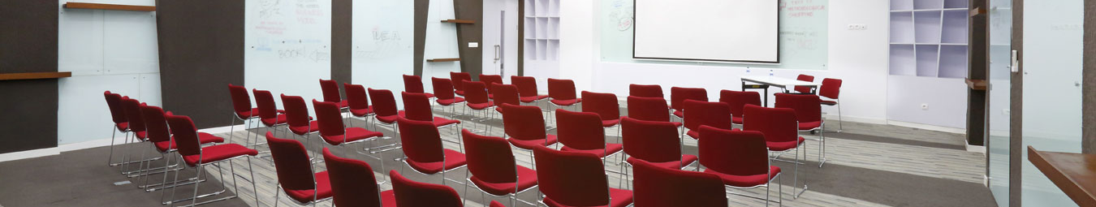
Environment Protection Training Center
EP
Training
Center

Slide 16


